Slide 1
Design of Accumulator Logic
Adder and logic circuit,
&
Control gates

Slide 2
Design of Accumulator Logic
Accumulator is the personal register for CPU.
It is used to hold intermediate values.

Slide 3
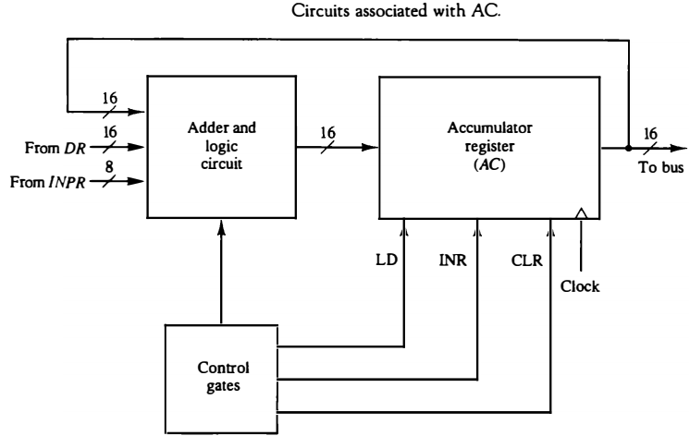
Design of Accumulator Logic
The circuits associated with the AC register are shown in Fig.
The adder and logic circuit has three sets of inputs.
One set of 16 inputs comes from the outputs of AC .
Another set of 16 inputs comes from the data register DR .
A third set of eight inputs comes from the input register INPR .

Slide 4
Design of Accumulator Logic
The outputs of the adder and logic circuit provide the data inputs for the register.
It is necessary to include logic gates for controlling the LD, INR, and CLR in the register and for controlling the operation of the adder and logic circuit.

Slide 5
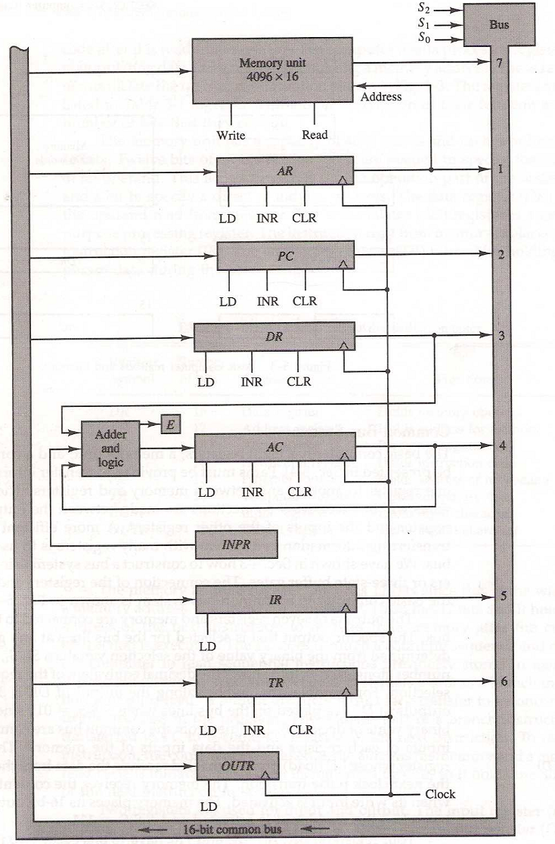
Basic computer registers connected to a common bus

Slide 6
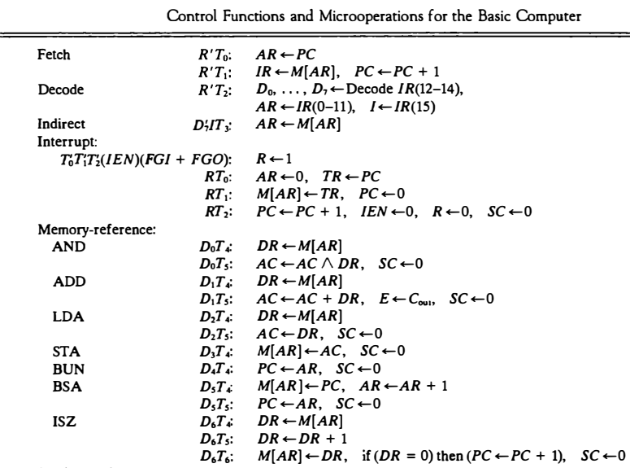
Design of Accumulator Logic
In order to design the logic associated with AC, it is necessary to go over the register transfer statements

Slide 7
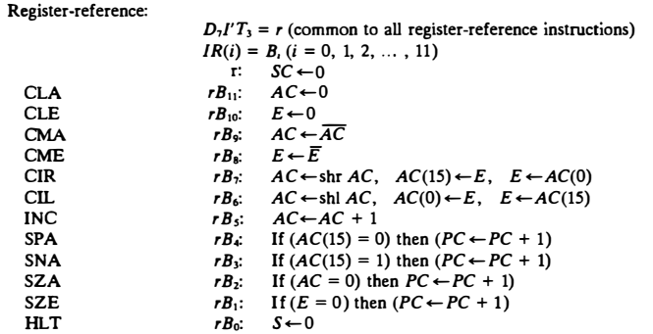

Slide 8
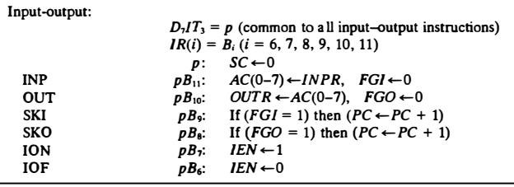

Slide 9
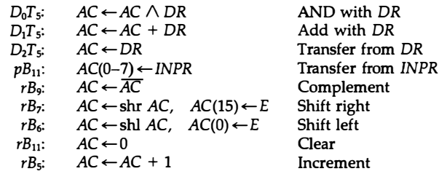
Design of Accumulator Logic
Extracted all the statements that change the content of AC.
From this list we can derive the control logic gates and the adder and logic circuit.

Slide 10
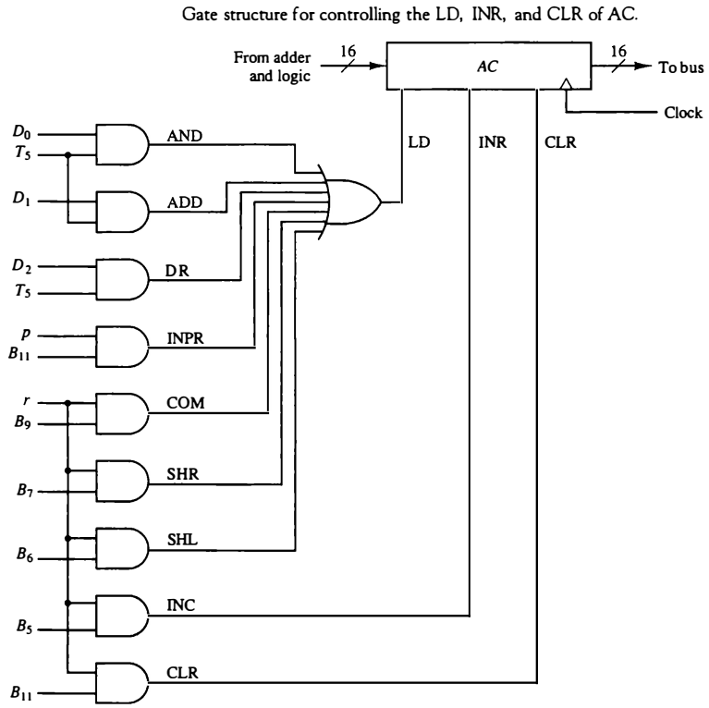
Gate structure for controlling LD, lNR, and CLR
The control function for the clear microoperation is rB₁₁, where r = D7l'T3 and B₁₁ = IR(11).
The output of the AND gate that generates this control function is connected to the CLR input of the register.

Slide 11
Gate structure for controlling LD, lNR, and CLR
Similarly, the output of the gate that implements the increment microoperation is connected to the INR input of the register.
The other seven microoperations are generated in the adder and logic circuit and are loaded into AC at the proper time.

Slide 12
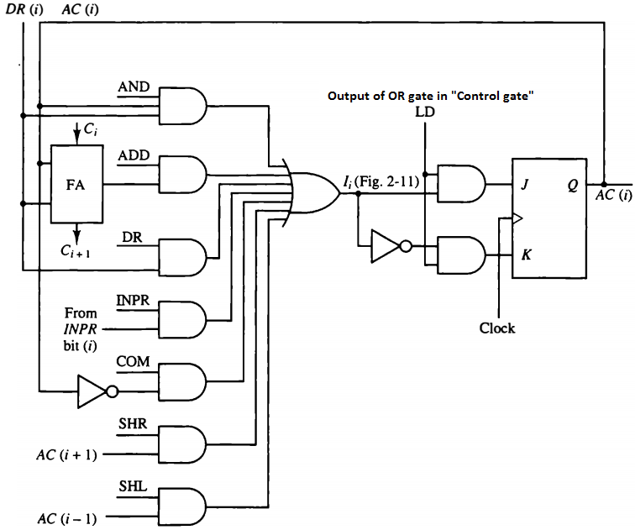
Adder and Logic Circuit
One stage of the adder and logic circuit consists of seven AND gates, one OR gate and a full-adder (FA).
The inputs of the gates with symbolic names come from the outputs of gates marked with the same symbolic name in “Gate structure for controlling LD, lNR, and CLR”.
For example, the input marked ADD in this Fig. is connected to the output marked ADD in Fig. “Gate…”.

Slide 13
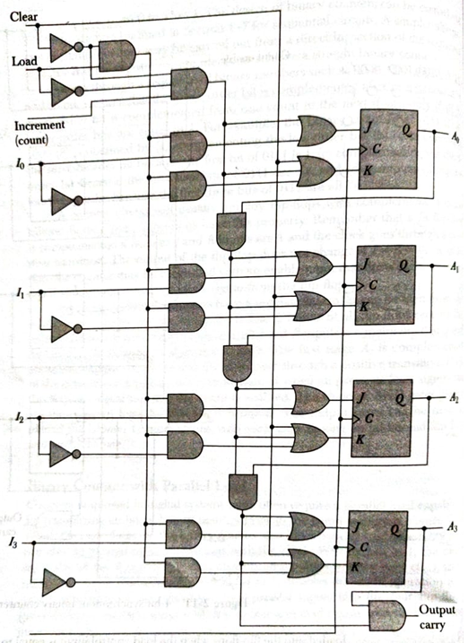
Internal construction of 4-bit register
The internal construction of 4-bit register is as shown in Fig. Each stage has a JK flip-flop, two OR gates, and two AND gates.
The load (LD) input is connected to the inputs of the AND gates.
When clear equal to I, the clear input sets all the K inputs to I, thus clearing all flip-flops with the next clock transition.

Slide 14
Internal construction of 4-bit register
The input load control when equal to I, disables the count operation and causes a transfer of data from the four parallel inputs into the four flip-flops (provided that the clear input is 0).
If the clear and load inputs are both 0 and the increment input is I, the circuit operates as a binary counter.

Slide 15
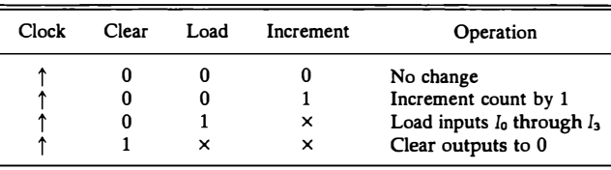
Internal construction of 4-bit register
The input data are loaded into the flip-flops when the load control input is equal to 1 provided that the clear is disabled, but the increment input can be 0 or 1.
The register is cleared to 0 with the clear control regardless of the values in the load and increment inputs

Slide 16
Adder and Logic Circuit
The AND operation is achieved by ANDing AC(i) with the corresponding bit in the data register DR(i). The ADD operation is obtained using a binary adder.
One stage of the adder uses a full-adder with the corresponding input and output carries.
The transfer from INPR to AC is only for bits 0 through 7.

Slide 17
Adder and Logic Circuit
The complement micro-operation is obtained by inverting the bit value in AC.
The shift-right operation transfers the bit from AC(i + 1), and the shift-left operation transfers the bit from AC(i - 1).
The complete adder and logic circuit consists of 16 stages connected together.

